Slide 1

CS1010: Programming Methodology
UNIT 27
N Queens

Slide 2
Unit 27: N Queens
N Queens

Slide 3
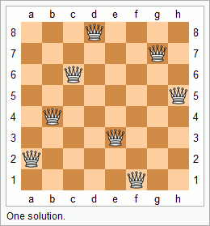
N Queens
Problem: Given a n x n chessboard, find a possible placement of n queens on the chessboard, such that the queens do not threaten each other
Example:
…#....
……#.
..#.....
…….#
.#......
….#...
#.......
…..#..

Slide 4
N Queens
Problem: Given a n x n chessboard, find a possible placement of n queens on the chessboard, such that the queens do not threaten each other
Recursive Thinking
A placement is a sequence of positions for n rows (e.g., {1, 2, 3, 4, 5, 6 ,7, 8})
There cannot be repeated positions since two queens cannot be in the same column.
What if we generate all permutations of the placements (recursively) and check whether it works?

Slide 5
N Queens
Implementation:
O(n!)
void nqueens(char queens[], long n, long row) {
if (row == n-1) {
if (!threaten_each_other_diagonally(queens, n)) {
cs1010_println_string(queens);
}
return;
}
nqueens(queens, n, row + 1);
for (long i = row + 1; i < n; i++) {
swap(queens, row, i);
nqueens(queens, n, row + 1);
swap(queens, row, i);
}
}

Slide 6
N Queens
Problem: Given a n x n chessboard, find a possible placement of n queens on the chessboard, such that the queens do not threaten each other
Improvement
Observation: Any placement starting with {1, 2, …} cannot work since the first two queens already threaten each other.
Permutate further only if the existing positions of the placement does not fail the check.

Slide 7
N Queens
Implementation:
void nqueens(char queens[], long n, long row) {
…
if (!threaten_each_other_diagonally(queens, row)) {
nqueens(queens, n, row + 1);
}
for (long i = row + 1; i < n; i++) {
swap(queens, row, i);
if (!threaten_each_other_diagonally(queens, row)) {
nqueens(queens, n, row + 1);
}
swap(queens, row, i);
}
}

Slide 8
Homework
Post-Lecture Diagnostic Quiz and Assignment 7
Due on Monday of Week 12, 4pm (extended due to public holiday)
Problem Set 25-27
To be discussed in Week 12 during tutorials.
PE2
Check out the general information / past year questions and start your preparation!

